Slide 1

LLM-FIne Tuned Financial Advisor
Northeastern University
DS5500: Data Science Capstone
Team Pitch
Laasya Anantha Prasad
Krishna Venkatesh
Rakshak Kunchum

Slide 2
Introduction
A Financial LLM Advisor utilizes advanced fine-tuning techniques on large language models to specifically cater to the financial sector, enhancing precision in tasks such as market analysis, risk assessment, customer service and any personal financial advice.
These models are becoming integral in finance for automating complex tasks, providing insights from large data sets, and improving decision-making processes through high-level predictive analytics.

Slide 3
Goals and Outcome
The aim is to develop a model that can interpret and analyze financial text with high accuracy, assist in decision making, and personalize financial advice based on user data for credit cards, investments, stocks, portfolio management and financial risk.
Expected benefits include the ability to process vast amounts of financial data quickly and accurately, offer advice related to stock markets, and provide customized financial advice, improving client satisfaction.

Slide 4
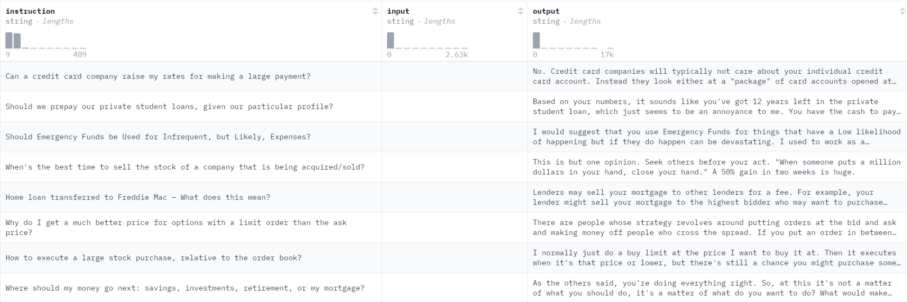
Potential Datasets
Historical financial data from sources such as Yahoo Finance, SEC filings, and user-generated financial advice from forums like Reddit posts. Additionally, data from financial news articles and investment blogs may be incorporated.
https://huggingface.co/datasets/winddude/reddit_finance_43_250k
https://huggingface.co/datasets/gbharti/finance-alpaca

Slide 5
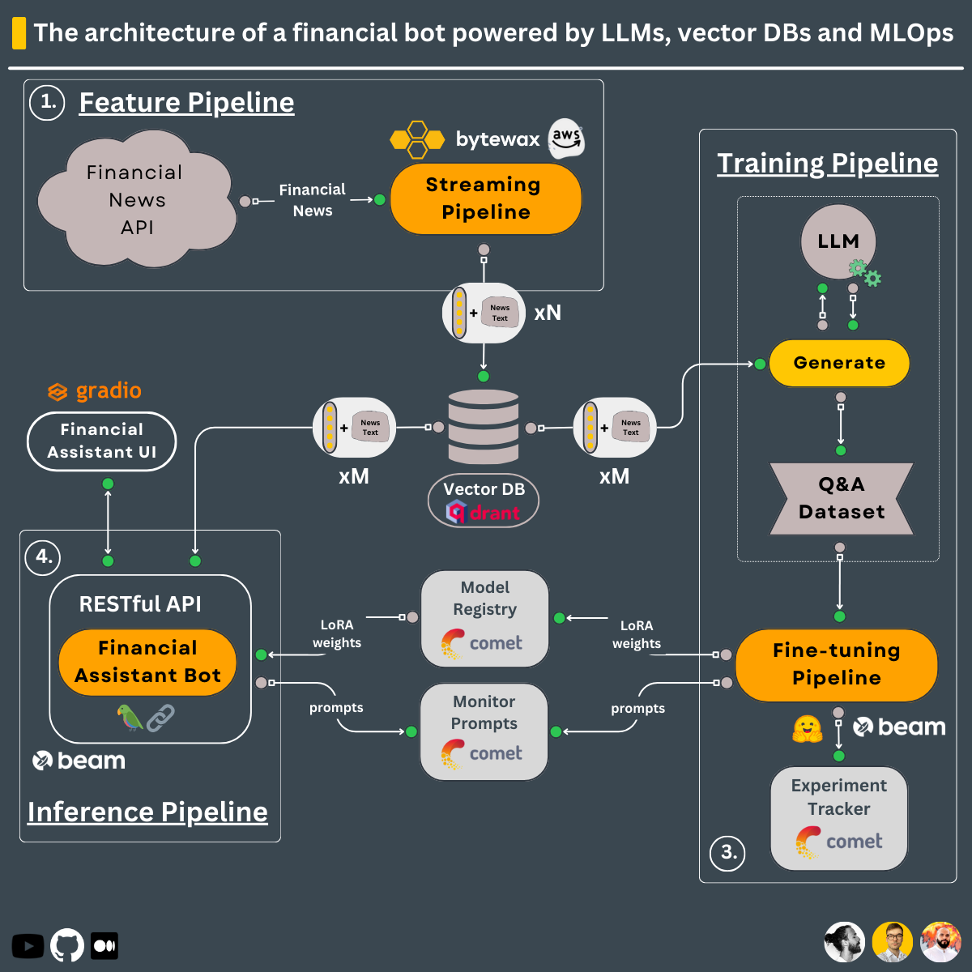
MEthodology
Feature Pipeline:
Financial news data is processed through a streaming pipeline and stored in a Vector DB (Qdrant).
Training Pipeline:
A pre-trained LLM generates a Q&A dataset from the news data for fine-tuning.
Model Fine-tuning and MLOps:
LoRA weights adjust the model parameters, with tracking done by Comet.
Inference Pipeline:
The fine-tuned model is deployed via a RESTful API to power the financial assistant bot.
Real-time Response:
The bot accesses the Vector DB to provide relevant responses based on user prompts.

Slide 6
Challenges and potential Risks
Challenges specific to financial models include handling the sensitivity of financial data, and ensuring compliance with financial regulations.
Risks include potential breaches in data security, the high stakes of erroneous financial advice, and ethical concerns over automated financial decisions.
Model Hallucinations and incorrect predictions.
LLM choice and RAG model Evaluation

Slide 7
CONCLUSIONS
a
B
C
Enhanced Decision-Making and Efficiency:
The Financial LLM Advisor can significantly improve the accuracy and speed of decision-making processes in the financial sector by automating complex tasks.
Personalized Financial Guidance for Individuals:
The Financial LLM Advisor offers tailored financial insights and advice to individuals, helping them make informed decisions about investments, savings, and risk management.
Scalable and Accessible Financial Services:
By leveraging advanced LLM fine-tuning, the project can make high-quality financial analysis and advice more accessible, allowing businesses and individuals to benefit from expert-level insights.

Slide 8
ThanK YoU

